Slide 1
2024年
体外受精・胚移植等の臨床実施成績

Slide 2
年別 治療周期数

Slide 3
年別 出生児数

Slide 4
年別 周期数
 | IVF（GIFT,その他を含む） |  |  |  |  |  | ICSI（SPLITを含む） |  |  |  |  |  | 凍結融解胚（卵）
西暦 | 治療周期数 | 採卵周期数 | 全凍結周期 | 移植周期数 | 妊娠周期数 | 出生児数 | 治療周期数 | 採卵周期数 | 全凍結周期 | 移植周期数 | 妊娠周期数 | 出生児数 | 治療周期数 | 移植周期数 | 妊娠周期数 | 出生児数
1985 | 1,195 | 1,195 |  | 862 | 64 | 27
1986 | 752 | 752 |  | 556 | 56 | 16
1987 | 1,503 | 1,503 |  | 1,070 | 135 | 54
1988 | 1,702 | 1,702 |  | 1,665 | 257 | 114
1989 | 4,218 | 3,890 |  | 2,968 | 580 | 446 |  |  |  |  |  |  | 184 | 92 | 7 | 3
1990 | 7,405 | 6,892 |  | 5,361 | 1,178 | 1,031 |  |  |  |  |  |  | 160 | 153 | 17 | 17
1991 | 11,177 | 10,581 |  | 8,473 | 2,015 | 1,661 |  |  |  |  |  |  | 369 | 352 | 57 | 39
1992 | 17,404 | 16,381 |  | 12,250 | 2,702 | 2,525 | 963 | 936 |  | 524 | 42 | 35 | 553 | 530 | 79 | 66
1993 | 21,287 | 20,345 |  | 15,565 | 3,730 | 3,334 | 2,608 | 2,447 |  | 1,271 | 176 | 149 | 681 | 597 | 86 | 71
1994 | 25,157 | 24,033 |  | 18,690 | 4,069 | 3,734 | 5,510 | 5,339 |  | 4,114 | 759 | 698 | 1,303 | 1,112 | 179 | 144
1995 | 26,648 | 24,694 |  | 18,905 | 4,246 | 3,810 | 9,820 | 9,054 |  | 7,722 | 1,732 | 1,579 | 1,682 | 1,426 | 323 | 298
1996 | 27,338 | 26,385 |  | 21,492 | 4,818 | 4,436 | 13,438 | 13,044 |  | 11,269 | 2,799 | 2,588 | 2,900 | 2,676 | 449 | 386
1997 | 32,247 | 30,733 |  | 24,768 | 5,730 | 5,060 | 16,573 | 16,376 |  | 14,275 | 3,495 | 3,249 | 5,208 | 4,958 | 1,086 | 902
1998 | 34,929 | 33,670 |  | 27,436 | 6,255 | 5,851 | 18,657 | 18,266 |  | 15,505 | 3,952 | 3,701 | 8,132 | 7,643 | 1,748 | 1,567
1999 | 36,085 | 34,290 |  | 27,455 | 6,812 | 5,870 | 22,984 | 22,350 |  | 18,592 | 4,702 | 4,247 | 9,950 | 9,093 | 2,198 | 1,812
2000 | 31,334 | 29,907 |  | 24,447 | 6,328 | 5,447 | 26,712 | 25,794 |  | 21,067 | 5,240 | 4,582 | 11,653 | 10,719 | 2,660 | 2,245
2001 | 32,676 | 31,051 |  | 25,143 | 6,749 | 5,829 | 30,369 | 29,309 |  | 23,058 | 5,924 | 4,862 | 13,034 | 11,888 | 3,080 | 2,467
2002 | 34,953 | 33,849 |  | 26,854 | 7,767 | 6,443 | 34,824 | 33,823 |  | 25,866 | 6,775 | 5,486 | 15,887 | 14,759 | 4,094 | 3,299
2003 | 38,575 | 36,480 |  | 28,214 | 8,336 | 6,608 | 38,871 | 36,663 |  | 27,895 | 7,506 | 5,994 | 24,459 | 19,641 | 6,205 | 4,798
2004 | 41,619 | 39,656 |  | 29,090 | 8,542 | 6,709 | 44,698 | 43,628 |  | 29,946 | 7,768 | 5,921 | 30,287 | 24,422 | 7,606 | 5,538
2005 | 42,822 | 40,471 |  | 29,337 | 8,893 | 6,706 | 47,579 | 45,388 |  | 30,983 | 8,019 | 5,864 | 35,069 | 28,743 | 9,396 | 6,542
2006 | 44,778 | 42,248 |  | 29,440 | 8,509 | 6,256 | 52,539 | 49,854 |  | 32,509 | 7,904 | 5,401 | 42,171 | 35,804 | 11,798 | 7,930
2007 | 53,873 | 52,165 | 7,626 | 28,228 | 7,416 | 5,144 | 61,813 | 60,294 | 11,541 | 34,032 | 7,784 | 5,194 | 45,478 | 43,589 | 13,965 | 9,257
2008 | 59,148 | 57,217 | 10,139 | 29,124 | 6,897 | 4,664 | 71,350 | 69,864 | 15,390 | 34,425 | 7,017 | 4,615 | 60,115 | 57,846 | 18,597 | 12,425
2009 | 63,083 | 60,754 | 11,800 | 28,559 | 6,891 | 5,046 | 76,790 | 75,340 | 19,046 | 35,167 | 7,330 | 5,180 | 73,927 | 71,367 | 23,216 | 16,454
2010 | 67,714 | 64,966 | 13,843 | 27,905 | 6,556 | 4,657 | 90,677 | 88,822 | 24,379 | 37,172 | 7,699 | 5,277 | 83,770 | 81,300 | 27,382 | 19,011
2011 | 71,422 | 68,651 | 16,202 | 27,284 | 6,341 | 4,546 | 102,473 | 100,518 | 30,773 | 38,098 | 7,601 | 5,415 | 95,764 | 92,782 | 31,721 | 22,465
2012 | 82,108 | 79,434 | 20,627 | 29,693 | 6,703 | 4,740 | 125,229 | 122,962 | 41,943 | 40,829 | 7,947 | 5,498 | 119,089 | 116,176 | 39,106 | 27,715
2013 | 89,950 | 87,104 | 25,085 | 30,164 | 6,817 | 4,776 | 134,871 | 134,871 | 49,316 | 41,150 | 8,027 | 5,630 | 141,335 | 138,249 | 45,392 | 32,148
2014 | 92,269 | 89,397 | 27,624 | 30,414 | 6,970 | 5,025 | 144,247 | 141,888 | 55,851 | 41,437 | 8,122 | 5,702 | 157,229 | 153,977 | 51,458 | 36,595
2015 | 93,614 | 91,079 | 30,498 | 28,858 | 6,478 | 4,629 | 155,797 | 153,639 | 63,660 | 41,396 | 8,169 | 5,761 | 174,740 | 171,495 | 56,888 | 40,611
2016 | 94,566 | 92,185 | 34,188 | 26,182 | 5,903 | 4,266 | 161,262 | 159,214 | 70,387 | 38,315 | 7,324 | 5,166 | 191,962 | 188,338 | 62,749 | 44,678
2017 | 91,516 | 89,447 | 36,441 | 22,423 | 5,182 | 3,731 | 157,709 | 155,758 | 74,200 | 33,297 | 6,757 | 4,826 | 198,985 | 195,559 | 67,255 | 48,060
2018 | 92,552 | 90,376 | 38,882 | 20,894 | 4,755 | 3,402 | 158,859 | 157,026 | 79,496 | 29,569 | 5,886 | 4,194 | 203,482 | 200,050 | 69,395 | 49,383
2019 | 88,074 | 86,334 | 40,561 | 17,345 | 4,002 | 2,974 | 154,824 | 153,014 | 83,129 | 24,490 | 4,789 | 3,433 | 215,203 | 211,758 | 74,911 | 54,188
2020 | 82,883 | 81,286 | 42,530 | 13,362 | 3,094 | 2,282 | 151,732 | 150,082 | 87,697 | 19,061 | 3,626 | 2,596 | 215,285 | 211,914 | 76,196 | 55,503
2021 | 88,362 | 86,901 | 42,016 | 13,219 | 3,115 | 2,268 | 170,350 | 168,659 | 86,992 | 19,740 | 3,875 | 2,850 | 239,428 | 236,211 | 87,174 | 64,679
2022 | 91,402 | 89,807 | 49,433 | 12,211 | 3,007 | 2,183 | 187,816 | 185,489 | 108,814 | 19,299 | 3,878 | 2,822 | 264,412 | 260,101 | 98,348 | 72,201
2023 | 89,854 | 88,378 | 52,317 | 9,209 | 2,329 | 1,761 | 195,657 | 193,287 | 116,026 | 15,534 | 3,375 | 2,502 | 276,153 | 271,361 | 109,850 | 80,774
2024 | 86,626 | 85,236 | 53,397 | 6,736 | 1,843 | 1,391 | 194,716 | 192,732 | 118,204 | 11,785 | 2,699 | 1,994 | 268,923 | 263,853 | 112,432 | 83,088

Slide 5
ART治療周期数 2024

Slide 6
ART妊娠率・生産率・流産率 2024

Slide 7
ART妊娠率・生産率・流産率 2024

Slide 8
2024
年齢別 | 総治療周期数 | 総治療周期数（全凍結周期をのぞく） | 移植周期数 | 妊娠周期数 | 多胎数 （胎嚢確認時） | 流産数 | 生産周期数 | 妊娠率/総ET | 妊娠率/総治療 | 生産率/総治療 | 妊娠率/総治療(全凍結周期をのぞく) | 生産率/総治療(全凍結周期をのぞく) | 流産率/総妊娠 | 多胎率
20歳以下 | 107 | 30 | 13 | 6 | 0 | 0 | 6 | 46.2% | 5.6% | 5.6% | 20.0% | 20.0% | 0.0% | 0.00%
21 | 60 | 30 | 26 | 14 | 0 | 1 | 12 | 53.8% | 23.3% | 20.0% | 46.7% | 40.0% | 7.1% | 0.00%
22 | 133 | 66 | 53 | 28 | 0 | 5 | 23 | 52.8% | 21.1% | 17.3% | 42.4% | 34.8% | 17.9% | 0.00%
23 | 300 | 163 | 135 | 81 | 5 | 13 | 66 | 60.0% | 27.0% | 22.0% | 49.7% | 40.5% | 16.0% | 6.17%
24 | 647 | 380 | 326 | 211 | 8 | 32 | 171 | 64.7% | 32.6% | 26.4% | 55.5% | 45.0% | 15.2% | 3.79%
25 | 1,437 | 859 | 750 | 405 | 15 | 58 | 330 | 54.0% | 28.2% | 23.0% | 47.1% | 38.4% | 14.3% | 3.70%
26 | 3,141 | 1,911 | 1,658 | 922 | 44 | 162 | 725 | 55.6% | 29.4% | 23.1% | 48.2% | 37.9% | 17.6% | 4.77%
27 | 5,952 | 3,741 | 3,263 | 1,786 | 67 | 307 | 1,412 | 54.7% | 30.0% | 23.7% | 47.7% | 37.7% | 17.2% | 3.75%
28 | 9,760 | 6,123 | 5,322 | 2,932 | 111 | 462 | 2,351 | 55.1% | 30.0% | 24.1% | 47.9% | 38.4% | 15.8% | 3.79%
29 | 15,139 | 9,637 | 8,321 | 4,488 | 168 | 748 | 3,580 | 53.9% | 29.6% | 23.6% | 46.6% | 37.1% | 16.7% | 3.74%
30 | 19,667 | 12,708 | 11,081 | 5,917 | 226 | 1,029 | 4,625 | 53.4% | 30.1% | 23.5% | 46.6% | 36.4% | 17.4% | 3.82%
31 | 22,756 | 15,029 | 13,110 | 6,947 | 259 | 1,267 | 5,438 | 53.0% | 30.5% | 23.9% | 46.2% | 36.2% | 18.2% | 3.73%
32 | 26,064 | 17,490 | 15,127 | 7,771 | 276 | 1,449 | 6,055 | 51.4% | 29.8% | 23.2% | 44.4% | 34.6% | 18.6% | 3.55%
33 | 28,442 | 19,171 | 16,585 | 8,348 | 325 | 1,582 | 6,474 | 50.3% | 29.4% | 22.8% | 43.5% | 33.8% | 19.0% | 3.89%
34 | 32,158 | 21,659 | 18,516 | 9,130 | 347 | 1,860 | 6,943 | 49.3% | 28.4% | 21.6% | 42.2% | 32.1% | 20.4% | 3.80%
35 | 35,504 | 24,080 | 20,465 | 9,733 | 424 | 2,125 | 7,265 | 47.6% | 27.4% | 20.5% | 40.4% | 30.2% | 21.8% | 4.36%
36 | 35,970 | 24,760 | 20,569 | 9,551 | 408 | 2,122 | 7,087 | 46.4% | 26.6% | 19.7% | 38.6% | 28.6% | 22.2% | 4.27%
37 | 35,979 | 24,727 | 20,142 | 8,960 | 416 | 2,187 | 6,472 | 44.5% | 24.9% | 18.0% | 36.2% | 26.2% | 24.4% | 4.64%
38 | 38,777 | 26,782 | 21,058 | 8,798 | 393 | 2,375 | 6,111 | 41.8% | 22.7% | 15.8% | 32.9% | 22.8% | 27.0% | 4.47%
39 | 45,124 | 30,699 | 23,042 | 8,829 | 345 | 2,673 | 5,828 | 38.3% | 19.6% | 12.9% | 28.8% | 19.0% | 30.3% | 3.91%
40 | 44,315 | 31,146 | 22,046 | 7,758 | 404 | 2,680 | 4,821 | 35.2% | 17.5% | 10.9% | 24.9% | 15.5% | 34.5% | 5.21%
41 | 40,597 | 28,290 | 18,348 | 5,845 | 279 | 2,273 | 3,361 | 31.9% | 14.4% | 8.3% | 20.7% | 11.9% | 38.9% | 4.77%
42 | 41,447 | 29,198 | 17,235 | 4,610 | 202 | 1,966 | 2,493 | 26.7% | 11.1% | 6.0% | 15.8% | 8.5% | 42.6% | 4.38%
43 | 24,872 | 17,988 | 10,556 | 2,193 | 90 | 1,023 | 1,099 | 20.8% | 8.8% | 4.4% | 12.2% | 6.1% | 46.6% | 4.10%
44 | 16,197 | 11,799 | 5,924 | 947 | 29 | 483 | 429 | 16.0% | 5.8% | 2.6% | 8.0% | 3.6% | 51.0% | 3.06%
45 | 10,955 | 8,250 | 3,756 | 420 | 7 | 226 | 177 | 11.2% | 3.8% | 1.6% | 5.1% | 2.1% | 53.8% | 1.67%
46 | 6,857 | 5,396 | 2,244 | 191 | 7 | 108 | 71 | 8.5% | 2.8% | 1.0% | 3.5% | 1.3% | 56.5% | 3.66%
47 | 3,686 | 2,963 | 1,224 | 76 | 1 | 49 | 27 | 6.2% | 2.1% | 0.7% | 2.6% | 0.9% | 64.5% | 1.32%
48 | 2,035 | 1,683 | 682 | 39 | 1 | 22 | 17 | 5.7% | 1.9% | 0.8% | 2.3% | 1.0% | 56.4% | 2.56%
49 | 1,173 | 1,008 | 396 | 18 | 0 | 6 | 12 | 4.5% | 1.5% | 1.0% | 1.8% | 1.2% | 33.3% | 0.00%
50歳以上 | 1,014 | 898 | 401 | 20 | 0 | 7 | 10 | 5.0% | 2.0% | 1.0% | 2.2% | 1.1% | 35.0% | 0.00%
合計 | 550,265 | 378,664 | 282,374 | 116,974 | 4,857 | 29,300 | 83,491 | 41.4% | 21.3% | 15.2% | 30.9% | 22.0% | 25.0% | 4.15%

Slide 9
ARTデータブック用語集
ART | 生殖補助医療
ET | 胚移植
FET | 凍結融解胚移植
GIFT | 配偶子（卵子・精子）卵管内移植
ICSI | 顕微授精（卵細胞質内精子注入法）
IVF | 体外受精
SPLIT | 1回の採卵で採取できた卵子を2つのグループに分け、IVFとICSIを行う方法
移植周期数 | 胚移植が実施された周期数
採卵周期数 | 採卵が実施された周期数（新鮮胚移植周期・全胚凍結周期・胚が得られなかった周期を含む）
生産周期数 | 出産（生産）に至った周期数
全胚凍結周期 | 採卵後周期のうち新鮮胚移植をすることなく全胚凍結を実施した周期
総治療周期数 | 実施されたすべての周期数
胎嚢 | 妊娠初期に妊卵の外周が環状の構造として超音波断層像に描出される部分をいう
多胎 | 2つ以上の胎芽・胎児が同時に子宮内に存在する状態
妊娠周期数 | 妊娠が成立した周期数（胎嚢が確認された周期）

Slide 10
付録1 令和8年度 登録・調査小委員会報告（抜粋）

Slide 11
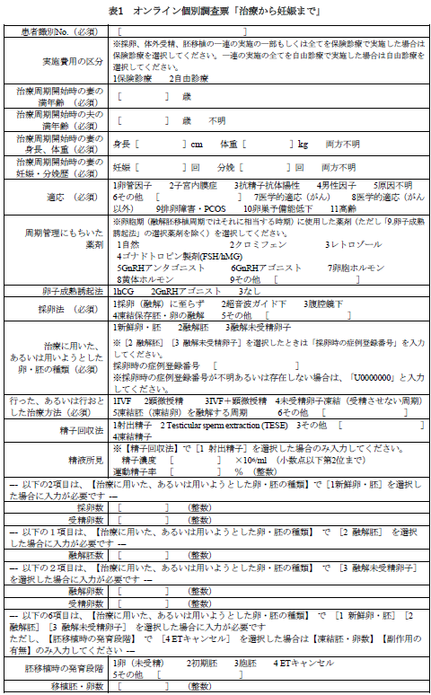
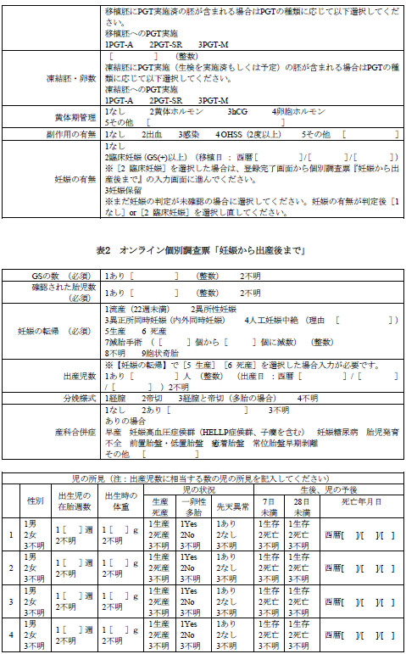

Slide 12
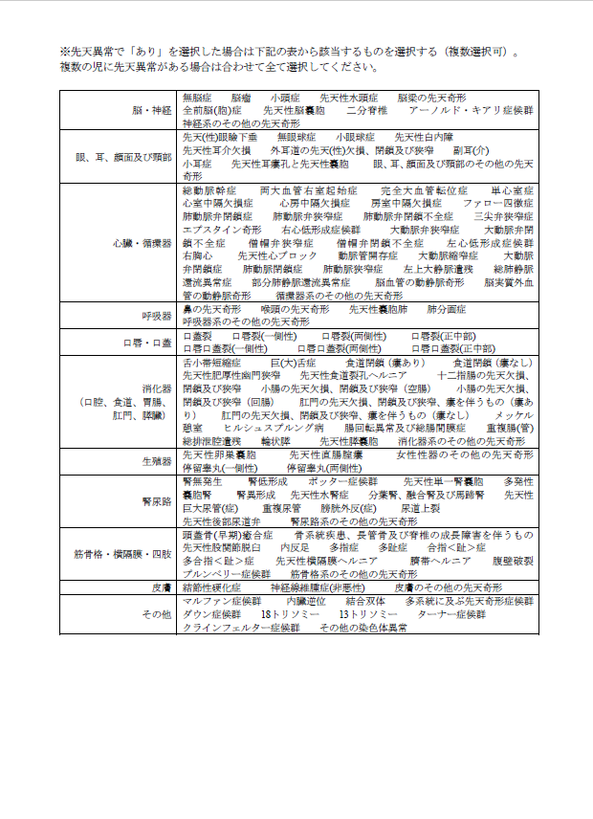
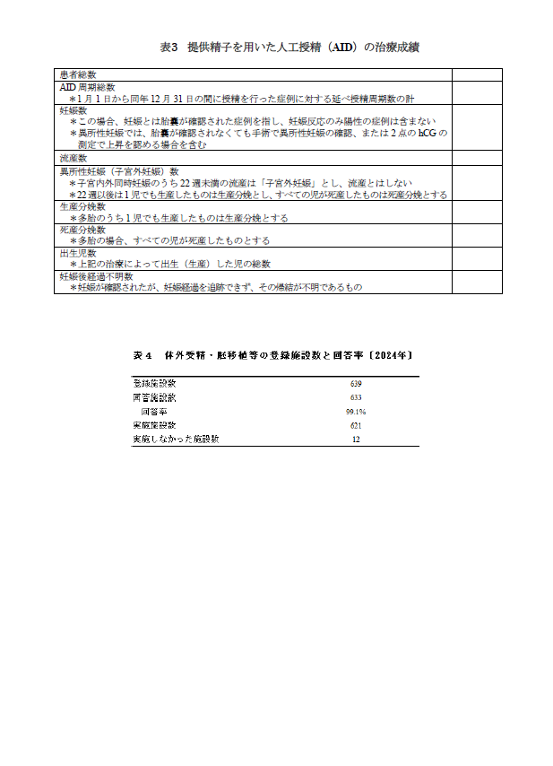

Slide 13
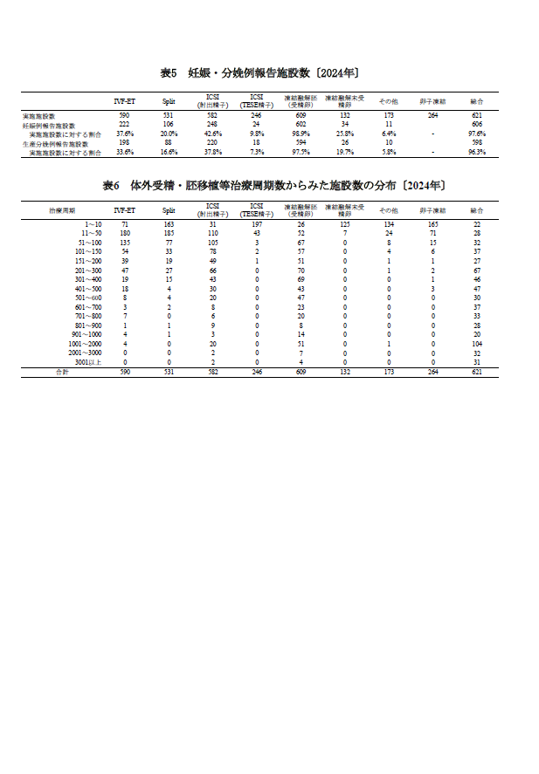
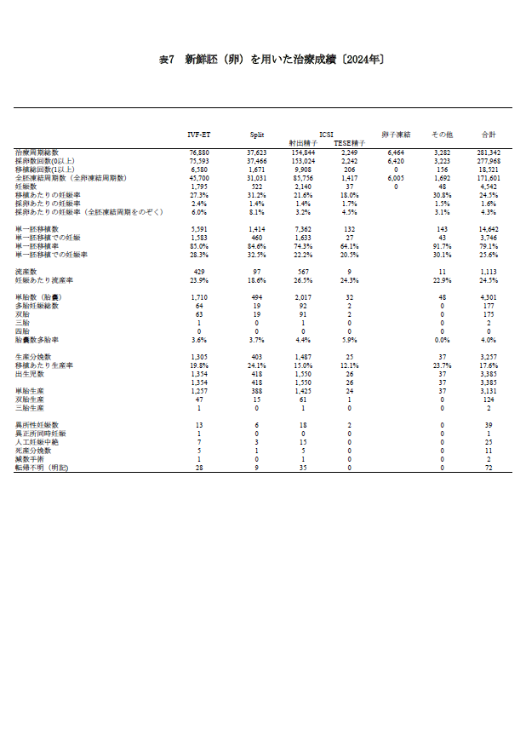

Slide 14
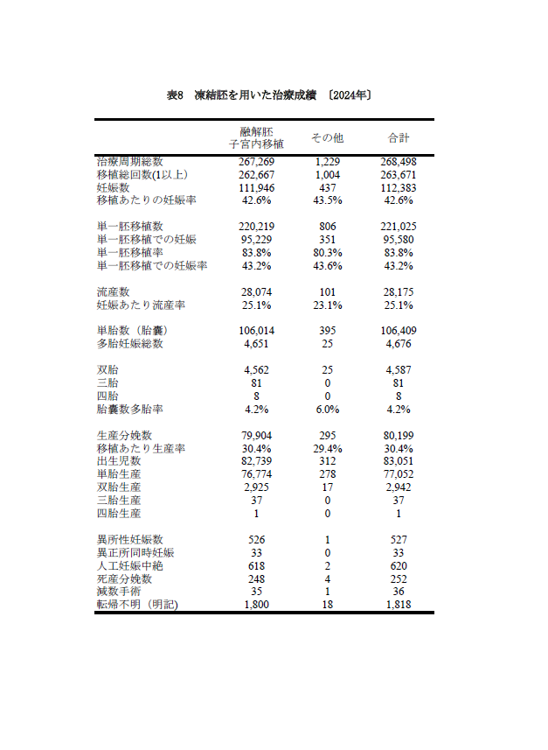
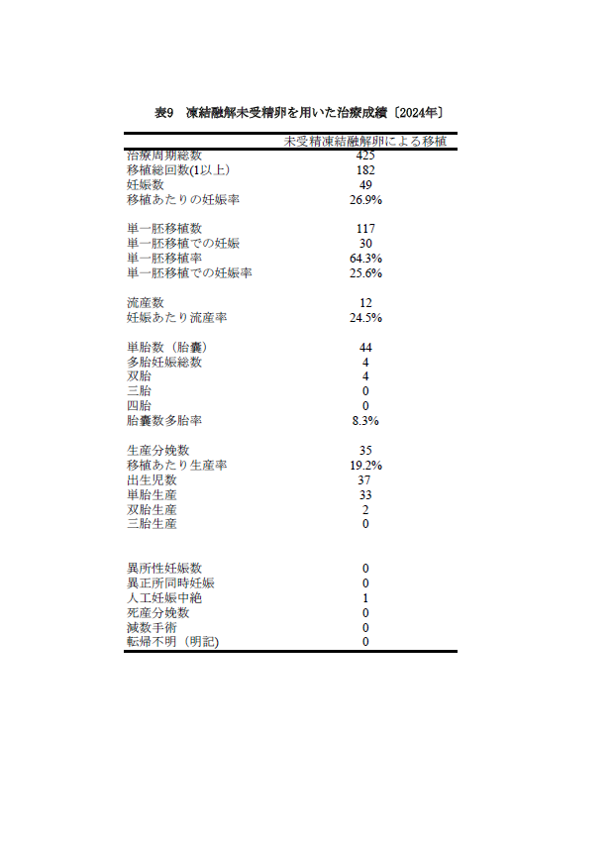

Slide 15
表10 提供精子を用いた人工授精（AID）の治療成績〔2024年〕
提供精子を用いた人工授精実施施設数 | 16
患者総数 | 338
AID周期総数 | 1,357
妊娠数 | 72
流産数 | 10
異所性妊娠（子宮外妊娠）数 | 1
生産分娩数 | 60
死産分娩数 | 0
出生児数 | 62
妊娠後経過不明数 | 1
表11 治療法別出生児数および累積出生児数 〔2024年〕
 | 治療周期総数 | 出生児数 | 累積出生児数
新鮮胚（卵）を用いた治療 | 281,342 | 3,385 | 282,463
体外受精を用いた治療 | 86,626 | 1,391 | 149,452
顕微授精を用いた治療 | 194,716 | 1,994 | 133,011
凍結胚（卵）を用いた治療* | 268,923 | 83,088 | 807,359
合計 | 550,265 | 86,473 | 1,089,822
*凍結融解胚を用いた治療成績と凍結融解未受精卵を用いた治療成績の合計
（詳しくは「日本産科婦人科学会誌」を参照してください）

